Slide 1
Towards Quantum Algorithms for Learning with Errors
Shashwat Agrawal
Notes:
Good afternoon everyone. I’m honored to be given an opportunity to speak here.
I’ll be talking about some attempts for Quantum Algorithms for this problem called Learning with Errors.
In whatever quantum algorithms or reductions I’ll cover, I’ll be sketchy in the math at times.

Slide 2
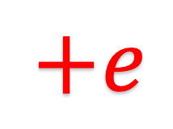
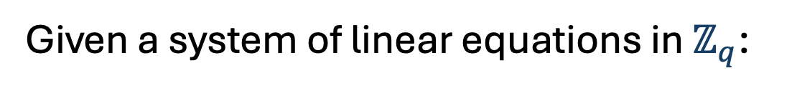

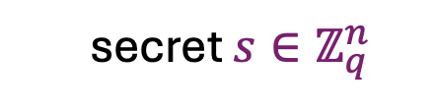

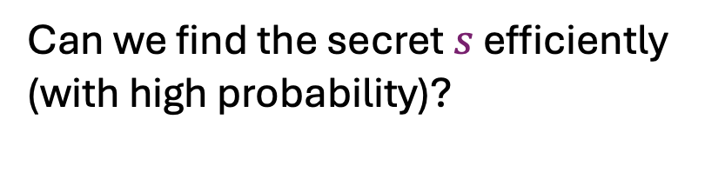


Learning with Errors
Given a system of linear equations in $ℤ_{q}$:
(Make RHS noisy)
  secret $s∈ℤ_{q}^{n}$
$$A$$
b =As
$$+e$$
noise vector $e$ from a distribution in$ℤ_{q}^{m}$
  we can efficiently find $s$
Can we find the secret $s$ efficiently (with high probability)?
$$m×n$$
  This simple innovation has baffled theorists and thrilled cryptographers
Notes:
Shweta has already talked about the learning with errors problem, so let us quickly recall it.
Suppose we’re given a system of linear equations in Z_q; q can be prime or may not be. So we’re given a matrix A of size m\times n, and we’re also given a vector b of length m, where b=A times s for some secret s. We can find s efficiently using, say, Gaussian elimination.
However, in the learning with errors problem, the vector b is a

Slide 3
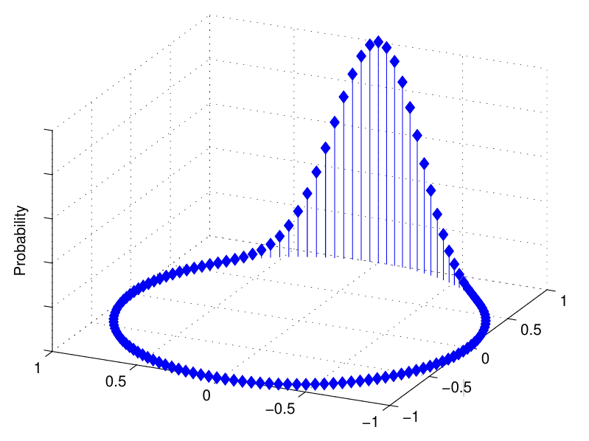

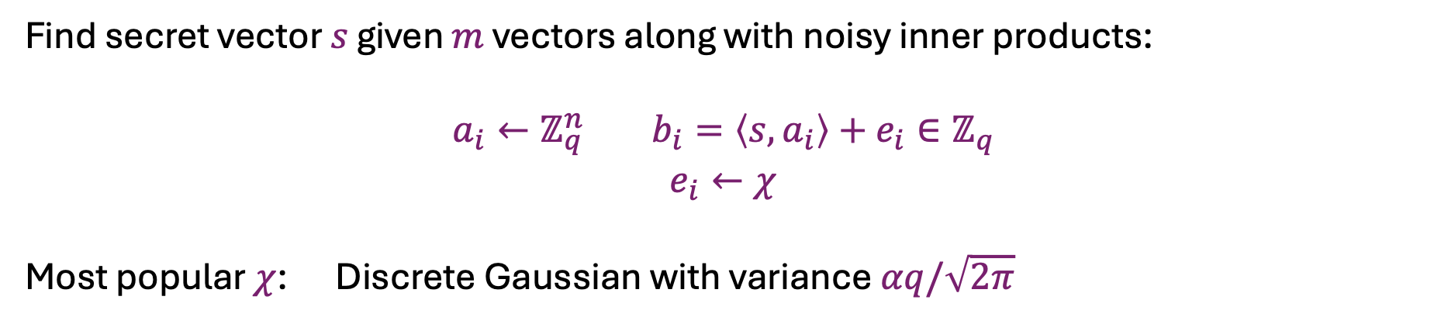



Learning with Errors
Find secret vector $s$ given $m$ vectors along with noisy inner products:
$$a_{i}←ℤ_{q}^{n} b_{i}=\left\langle s,a_{i}\right\rangle +e_{i}∈ℤ_{q}$$
$$e_{i}←χ$$
Most popular $χ$: Discrete Gaussian with variance $αq/\sqrt{2π}$
Discrete Gaussian
$$A=$$
$$−a_{i}−$$
$$b=$$
$$b_{i}$$
Notes:
To reiterate, we are given m vectors a_i drawn uniformly from Z_q^n, and we are also given noisy inner products of a_i with a secret vector s in Z_q^n
The noise or the error in each sample is an independent value chosen via a distribution in Z_q, say chi.
The most popular choice for chi is a discrete gaussian over Z_q with a variance alpha q / sqrt (2pi).

Slide 4
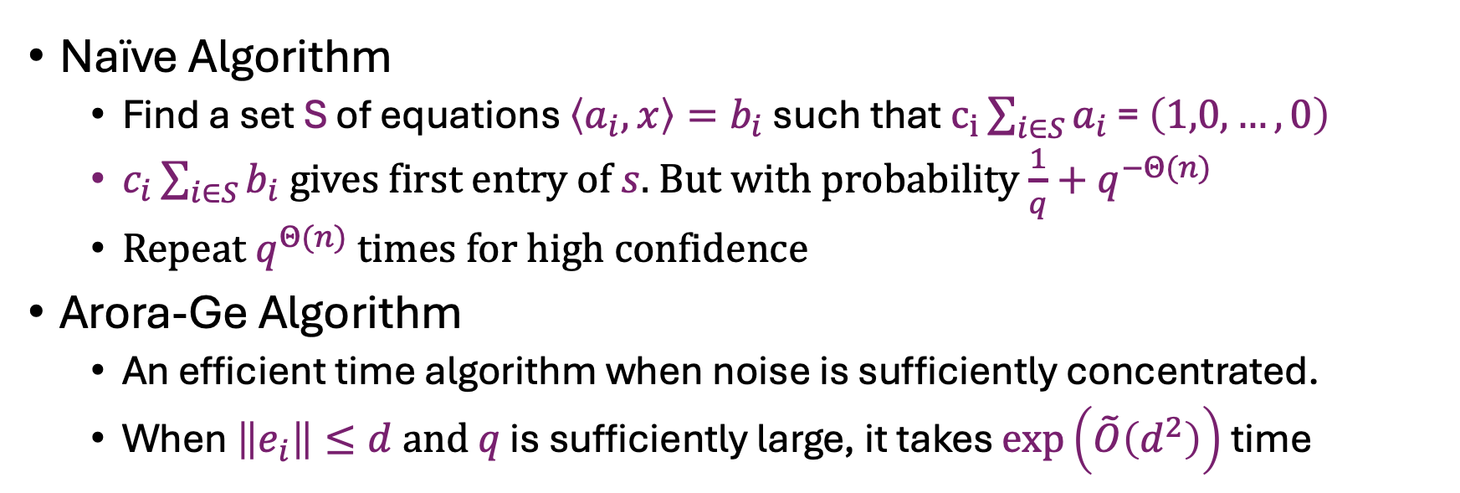
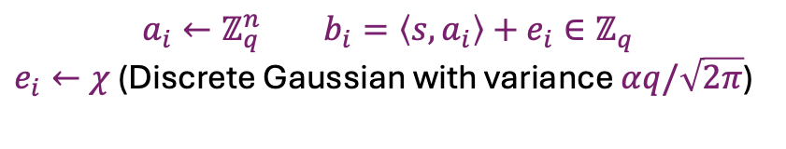
Classical Algorithms for LWE
$$a_{i}←ℤ_{q}^{n} b_{i}=\left\langle s,a_{i}\right\rangle +e_{i}∈ℤ_{q}$$
$e_{i}←χ$ (Discrete Gaussian with variance $αq/\sqrt{2π}$)
Naïve Algorithm
  Find a set S of equations $\left\langle a_{i},x\right\rangle =b_{i}$ such that $c_{i}\sum_{i∈S}{a_{i}}$ = $\left(1,0,…,0\right)$
  $c_{i}\sum_{i∈S}{b_{i}}$ gives first entry of $s$. But with probability ${\frac{1}{q}+q}^{−Θ(n)}$
  Repeat $q^{Θ(n)}$ times for high confidence
Arora-Ge Algorithm
  An efficient time algorithm when noise is sufficiently concentrated.
  When $\left\|e_{i}\right\|≤d and$ $q$ is sufficiently large, it takes $\exp\left(\tilde{O}\left(d^{2}\right)\right)$ time
No known sub-exponential or arbitrary small exponential time algorithm for $αq=Ω\left(\sqrt{n}\right)$
Notes:
Let us quickly see what happens if we try Gaussian elimination. Essentially, we need to find a set of equations on which we can apply a linear operation that makes the LHS coefficients 1,0,0..,0. And then we can apply the same linear operation on the RHS to get the first entry of s. But the guess is correct with negligible probability from random. This is because the scalars c_i can be very large, Omega(q), and they can really blow up the error in the RHS. So we need to repeat this strategy q^theta(n) times for high confidence.
Note that this algorithm can be bad even if the noise is guaranteed to be low, say noise can be +-1.
There is another algorithm by Arora and Ge, which can be efficient, say polynomial or sub-exponential when the noise is concentrated. For example

Slide 5
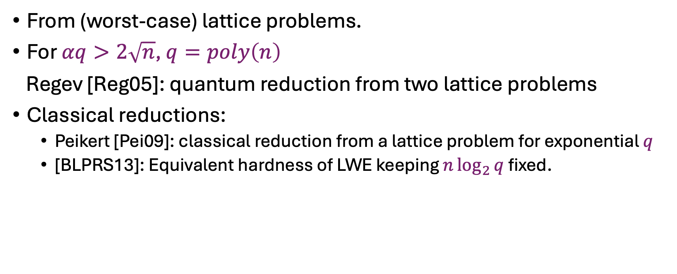
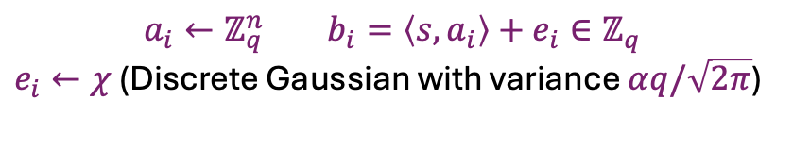
Hardness of LWE
$$a_{i}←ℤ_{q}^{n} b_{i}=\left\langle s,a_{i}\right\rangle +e_{i}∈ℤ_{q}$$
$e_{i}←χ$ (Discrete Gaussian with variance $αq/\sqrt{2π}$)
From (worst-case) lattice problems.
For $αq>2\sqrt{n}$, $q=poly\left(n\right)$
Regev [Reg05]: quantum reduction from two lattice problems
Classical reductions:
  Peikert [Pei09]: classical reduction from a lattice problem for exponential $q$
  [BLPRS13]: Equivalent hardness of LWE keeping $n\log_{2}{q}$ fixed.
Notes:
For a discrete Gaussian with sufficient variance, its hardness w.r.t. worst-case lattice problems was first established by a quantum reduction by Regev. Although those lattice problems do not have efficient quantum algorithms at present, they might have in the future, and then, this quantum reduction won’t support hardness of LWE.
So a classical reduction from such lattice problems was desirable, which could only rely on the classical hardness of a lattice problem. Peikert then gave a classical reduction from one lattice problem. This reduction required q to be exponential instead of polynomial.

Slide 6
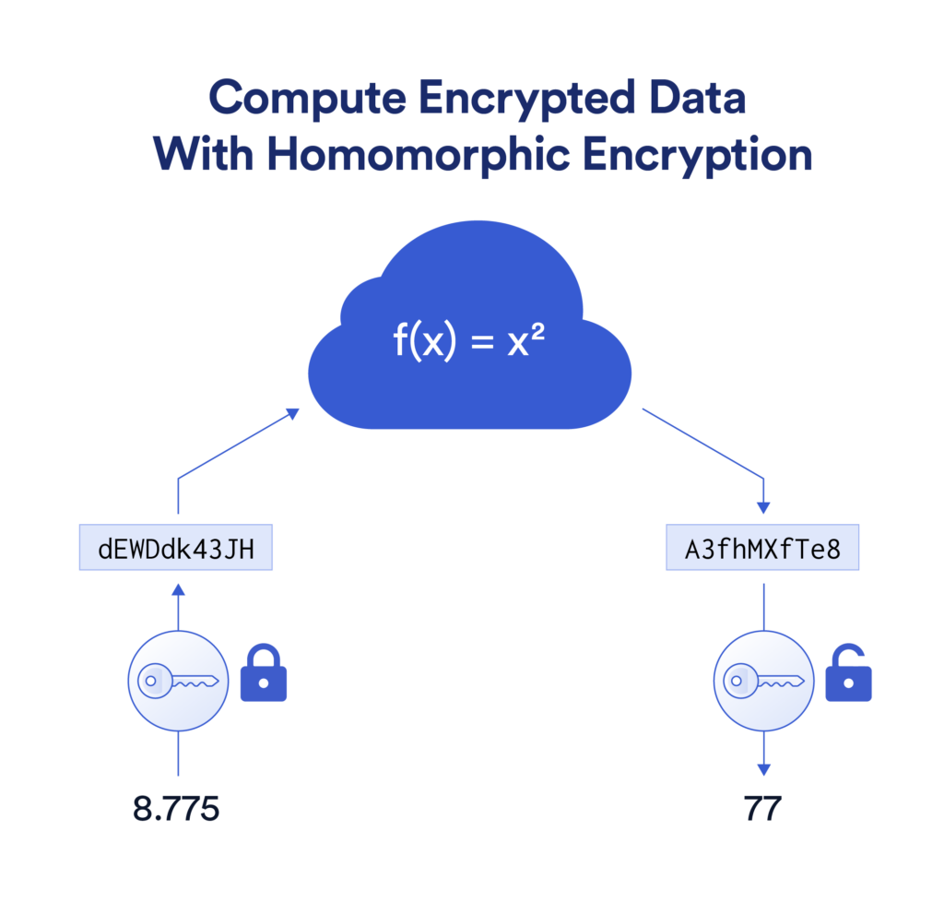
Versatility of LWE
Public Key Encryption
Advanced Primitives
  Fully Homomorphic Encryption (FHE)
  Attribute Based Encryption (ABE)
  Indistinguishability Obfuscation (iO)
  Lossy Trapdoor Functions (LTDF)
  Certifiable Deletion
  Quantum Homomorphic Encryption
Notes:
The reason LWE is so popular is because of its versatility. Shweta has already described how we can build Public Key Encryption from LWE. Moreover, we can also build other cryptographic primitives which support advanced functionalities. For eg., if we want to support computation over encrypted data, we have a primitive of Fully Homomorphic Encryption, which can be build assuming hardness of LWE. And we have many more advanced primitives.

Slide 7
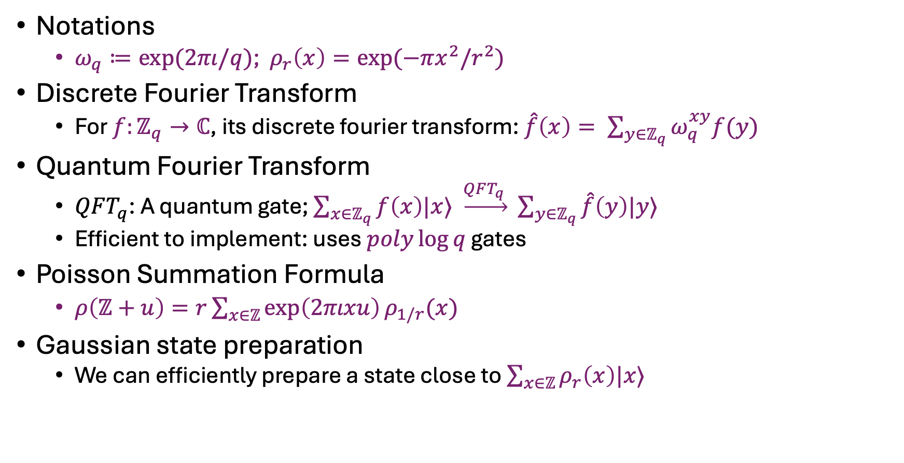
Some useful Math and Quantum
Notations
  $ω_{q}≔exp⁡(2πι/q)$; $ρ_{r}\left(x\right)=exp⁡(−πx^{2}/r^{2})$
Discrete Fourier Transform
  For $f:ℤ_{q}→ℂ$, its discrete fourier transform: $\hat{f}\left(x\right)= \sum_{y∈ℤ_{q}}{ω_{q}^{xy}f(y)}$
Quantum Fourier Transform
  $QFT_{q}$: A quantum gate; $\sum_{x∈ℤ_{q}}{f\left(x\right)|x⟩}$ $\underset{→}{QFT_{q} } \sum_{y∈ℤ_{q}}{\hat{f}\left(y\right)|y⟩}$
  Efficient to implement: uses $poly\log{q}$ gates
Poisson Summation Formula
  $ρ\left(ℤ+u\right)=r\sum_{x∈ℤ}{\exp\left(2πιxu\right)ρ_{1/r}(x)}$
Gaussian state preparation
  We can efficiently prepare a state close to $\sum_{x∈ℤ}{ρ_{r}\left(x\right)|x⟩}$

Slide 8
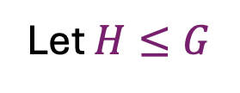
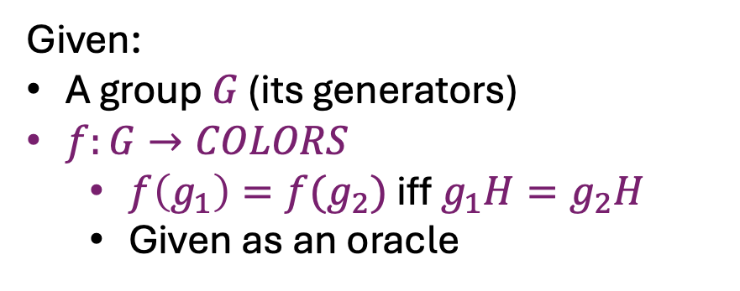
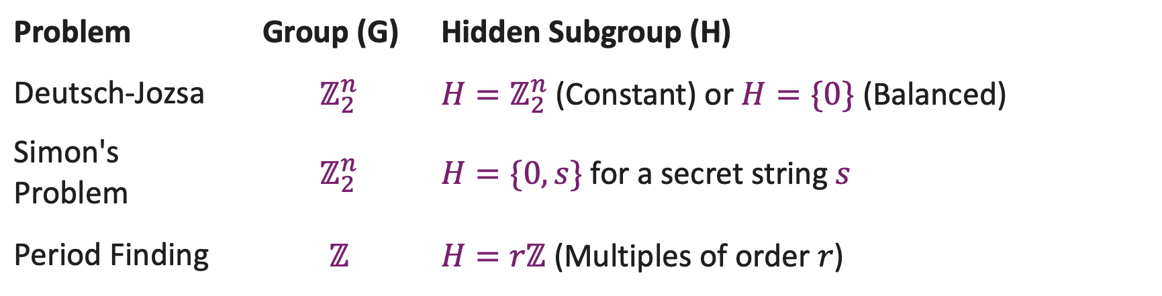
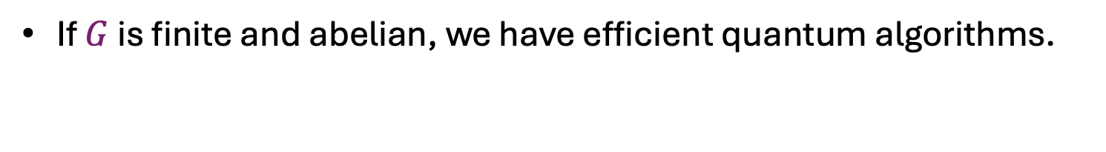
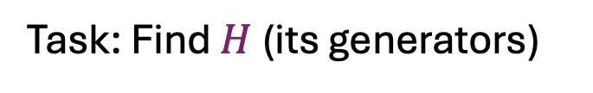
Hidden Subgroup Problem
Given:
A group $G$ (its generators)
$f:G→COLORS$
  $f\left(g_{1}\right)=f(g_{2})$ iff $g_{1}H=g_{2}H$
  Given as an oracle
Let $H≤G$
-3
-2
-1
0
1
2
3
Task: Find $H$ (its generators)
If $G$ is finite and abelian, we have efficient quantum algorithms.
Problem | Group (G) | Hidden Subgroup (H)
Deutsch-Jozsa | $$ℤ_{2}^{n}$$ | $H=ℤ_{2}^{n}$ (Constant) or $H=\{0\}$ (Balanced)
Simon's Problem | $$ℤ_{2}^{n}$$ | $H=\{0,s\}$ for a secret string $s$
Period Finding | $$ℤ$$ | $H=rℤ$ (Multiples of order $r$)

Slide 9
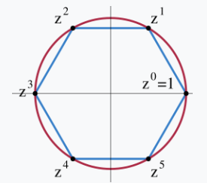

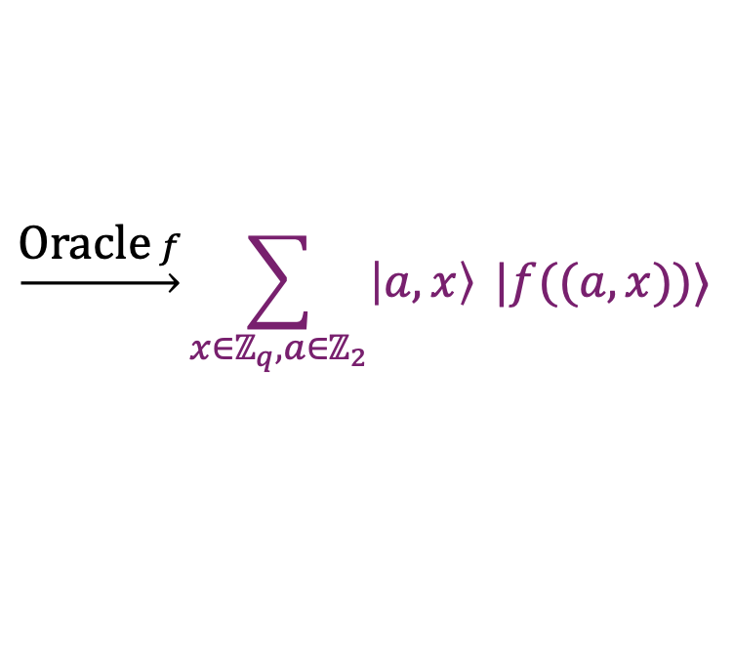
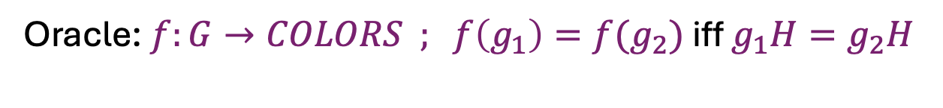

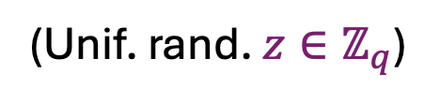
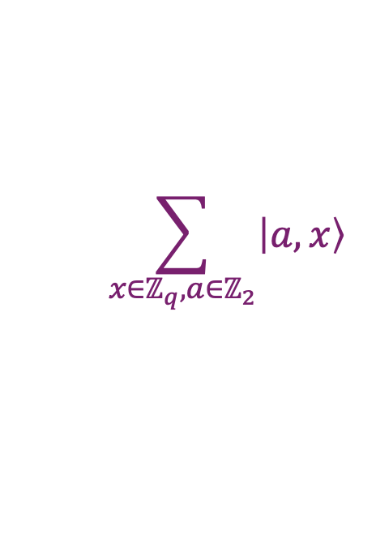





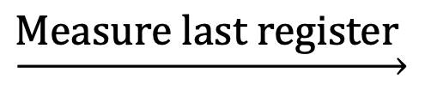
Dihedral Hidden Subgroup Problem
Dihedral Group of order $2q$: $D_{q}≔\left\langle r,t \right| r^{2}=t^{q}=1, rtr=t^{−1}⟩$
$$≅ℤ_{2}⋉ℤ_{q}$$
$$\left(a,x\right)⋅\left(b,y\right) ≔(a+b,x+{\left(−1\right)}^{a}y)$$
Hidden Subgroup: $H=\{\left(0,0\right),(1,s)\}$ for $s∈ℤ_{q}$
Oracle: $f:G→COLORS ; f\left(g_{1}\right)=f(g_{2})$ iff $g_{1}H=g_{2}H$
$$\left(0,z\right)⋅H= \{\left(0,z\right),(1,z+s)\}$$
$$\left(1,z\right)⋅H= \{\left(1,z\right),\left(0,z−s\right)\}$$
$$∴f\left(\left(0,z\right)\right)=f\left(\left(1,z+s\right)\right) ∀ z∈ℤ_{q}$$
A preprocessing : Get a superposition state of a coset
$$\sum_{x∈ℤ_{q}, a∈ℤ_{2}}{\left|a,x\right\rangle }$$
$$\underset{→}{\text{O}\text{racle} f}\sum_{x∈ℤ_{q}, a∈ℤ_{2}}{\left|a,x\right\rangle }|f((a,x))⟩$$
$$\left|0\right\rangle$$
$$\underset{→}{\text{Measure} \text{last} \text{register} }$$
$$\left|0,z\right\rangle +\left|1,z+s\right\rangle$$
(Unif. rand. $z∈ℤ_{q}$)

Slide 10
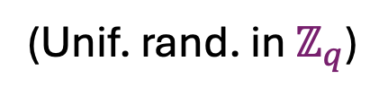


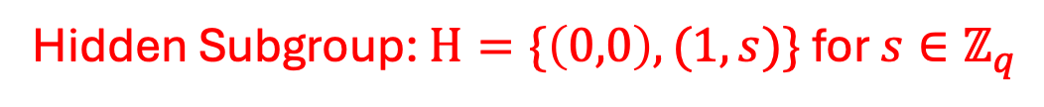

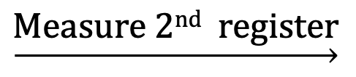

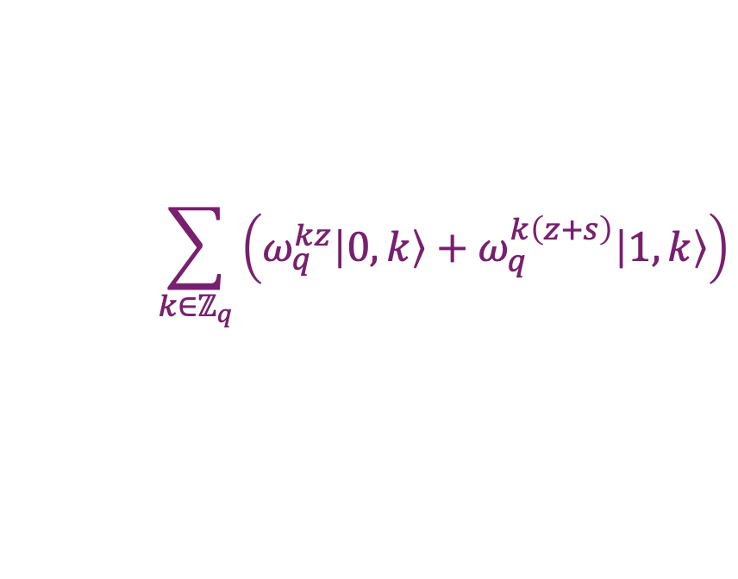
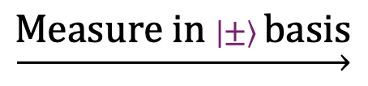
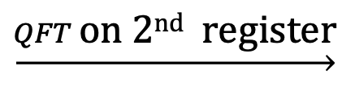
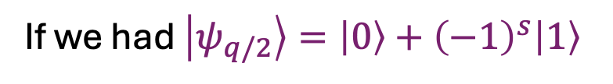
Dihedral Coset states
Hidden Subgroup: $H=\{\left(0,0\right),(1,s)\}$ for $s∈ℤ_{q}$
We can create random Dihedral Coset states:
$$\left|0,z\right\rangle +\left|1,z+s\right\rangle$$
Now we’ll apply QFT on first register
$$\left|0,z\right\rangle +\left|1,z+s\right\rangle$$
$$\underset{→}{QFT \text{o}\text{n}\text{ 2}\text{nd} \text{register}}$$
$$\sum_{k∈ℤ_{q}}{\left(ω_{q}^{kz}\left|0,k\right\rangle +ω_{q}^{k\left(z+s\right)}\left|1,k\right\rangle \right)}$$
(Unif. rand. in $ℤ_{q}$)
$$\underset{→}{\text{Measure}\text{ 2}\text{nd} \text{register}}$$
$$k, \left|ψ_{k}\right\rangle ≔\left|0\right\rangle +ω_{q}^{ks}\left|1\right\rangle$$
If we had $\left|ψ_{q/2}\right\rangle =\left|0\right\rangle +{\left(−1\right)}^{s}\left|1\right\rangle$
$$\underset{→}{\text{M}\text{easure} \text{in} \left|±\right\rangle \text{basis}}$$
$$\text{Get} \text{last} \text{bit} \text{of} s$$
Kuperberg’s idea: Collect lots of $\{k, \left|ψ_{k}\right\rangle \}$ and combine them cleverly to get $\left|ψ_{q/2}\right\rangle$
Combining: $\left|ψ_{k}\right\rangle \left|ψ_{k^{′}}\right\rangle \underset{→}{CNOT} \left|ψ_{k+k^{′}}\right\rangle \left|0\right\rangle +ω_{q}^{sk′}\left|ψ_{k−k^{′}}\right\rangle |1⟩$
Given $\exp\left(Θ\left(\sqrt{\log{q}}\right)\right)$samples, can find $s$ in $\exp\left(Θ\left(\sqrt{\log{q}}\right)\right)$time

Slide 11




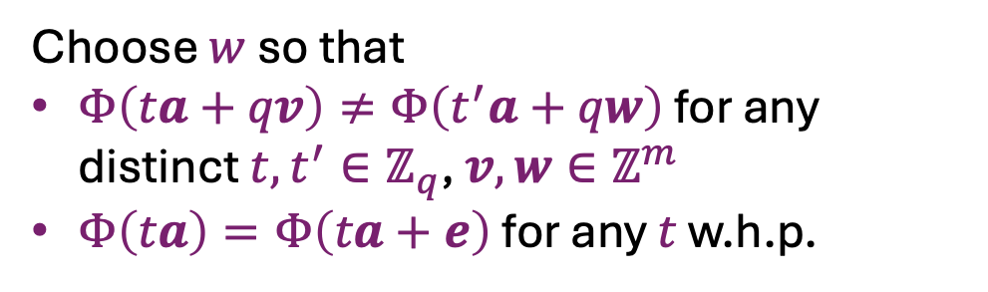






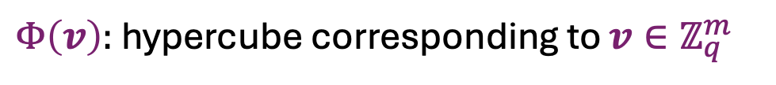


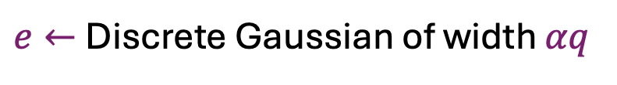
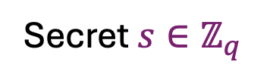


LWE reduces to (faulty) DCP
Let’s work with 1-dimensional LWE.
  Recall [BLPRS13]: Equivalent hardness of LWE keeping $n\log_{2}{q}$ fixed.
LWE input:
$$a←ℤ_{q}^{m×1}, b=sa+e$$
Secret $s∈ℤ_{q}$
$e←$Discrete Gaussian of width $αq$
Partition $ℤ_{q}^{m}$ into hypercubes of side length $w$
$$Φ(v)$$
$$v$$
$Φ\left(v\right):$ hypercube corresponding to $v∈ℤ_{q}^{m}$
Choose $w$ so that
$Φ\left(ta+qv\right)≠Φ\left(t^{′}a+qw\right)$ for any distinct $t,t^{′}∈ℤ_{q}$, $v,w∈ℤ^{m}$
$Φ\left(ta\right)=Φ\left(ta+e\right)$ for any $t$ w.h.p.
$$3a$$
2$a$
$$3a+e$$
$$a$$
$$a+e$$
$$2a+e$$
$$w\sqrt{m}≤O(q)$$
$$w≫αq\sqrt{m}$$
$$w$$

Slide 12
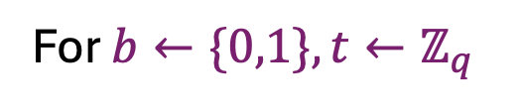
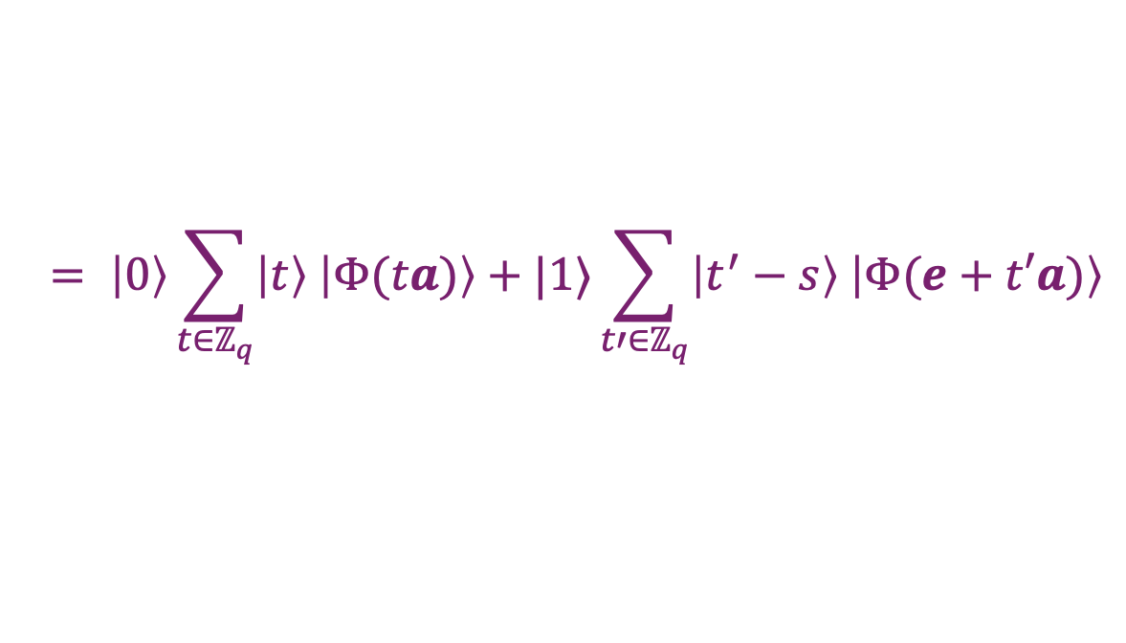



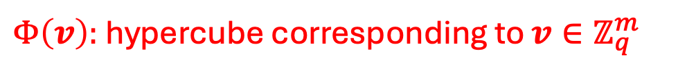

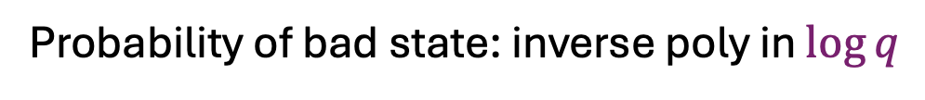
LWE reduces to (faulty) DCP
RHS of LWE: $b=sa+e$
$Φ\left(v\right):$ hypercube corresponding to $v∈ℤ_{q}^{m}$
Prepare the following state:
$$\left|0\right\rangle \sum_{t∈ℤ_{q}}{\left|t\right\rangle \left|Φ(ta)\right\rangle +|1⟩\sum_{t∈ℤ_{q}}{\left|t\right\rangle \left|Φ(b+ta)\right\rangle }}$$
$$= \left|0\right\rangle \sum_{t∈ℤ_{q}}{\left|t\right\rangle \left|Φ(ta)\right\rangle +|1⟩\sum_{t′∈ℤ_{q}}{\left|t^{′}−s\right\rangle \left|Φ(e+t′a)\right\rangle }}$$
Measure the last register
Good Case: Both $ta$ and $e+ta$ belong to the same cell
We are left with
$$\left|0,t\right\rangle +|1,t−s⟩$$
This is a Dihedral coset state!
Bad Case: $ta$ and $e+ta$ belong to different cells
We are left with
$$\left|b\right\rangle \left|t\right\rangle$$
For $b←\{0,1\}, t←ℤ_{q}$
Probability of bad state: inverse poly in $\log{q}$
Problem: We can’t detect which is the case, so can’t throw away a bad state
$∴$ Can only produce poly many correct states w.h.p. instead of $\exp\left(Θ\left(\sqrt{\log{q}}\right)\right)$

Slide 13
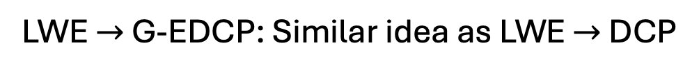

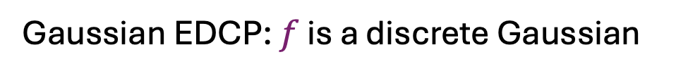

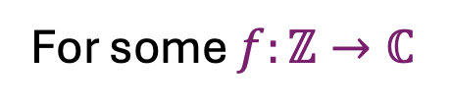
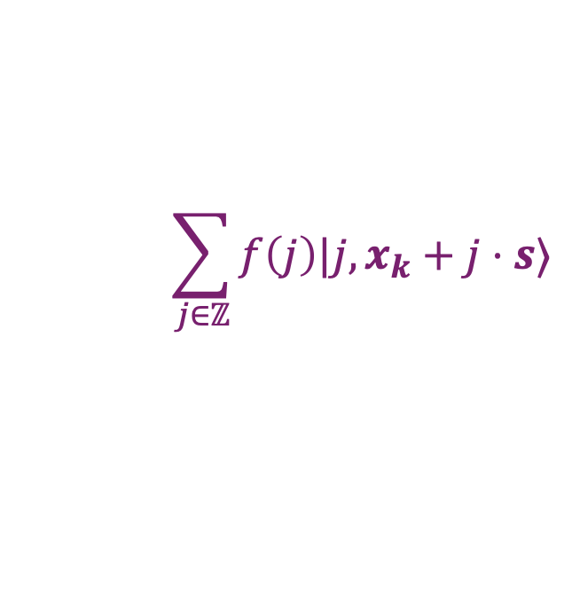

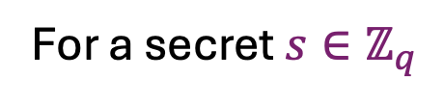
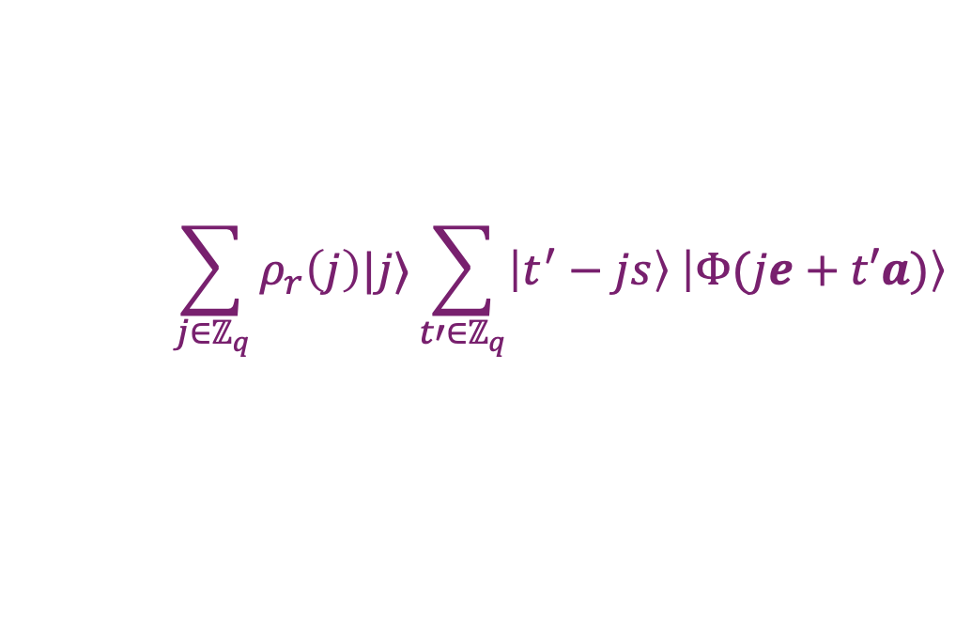
LWE $≡$ Extrapolated DCP
DCP states:
$$\left|0,x_{k}\right\rangle +\left|1,x_{k}+s\right\rangle$$
For a secret $s∈ℤ_{q}$
Extrapolated DCP states:
$$\sum_{j∈ℤ}{f\left(j\right)|j,x_{k}+j⋅s⟩}$$
For some $f:ℤ→ℂ$
Gaussian EDCP: $f$ is a discrete Gaussian
$f\left(j\right)=ρ_{r}\left(j\right)=e^{−πj^{2}/r^{2}}$
[BKSW18]: Quantum equivalence of LWE and Gaussian EDCP
LWE $→$ G-EDCP: Similar idea as LWE $→$ DCP
$$\sum_{j∈ℤ_{q}}{ρ_{r}\left(j\right)|j⟩\sum_{t′∈ℤ_{q}}{\left|t^{′}−js\right\rangle \left|Φ(je+t′a)\right\rangle }}$$
and again measure last register
This time start with
Good Case: For sufficiently large $j$, all $je+t′a$belong to the same cell
Again, can only produce poly many correct states w.h.p.

Slide 14
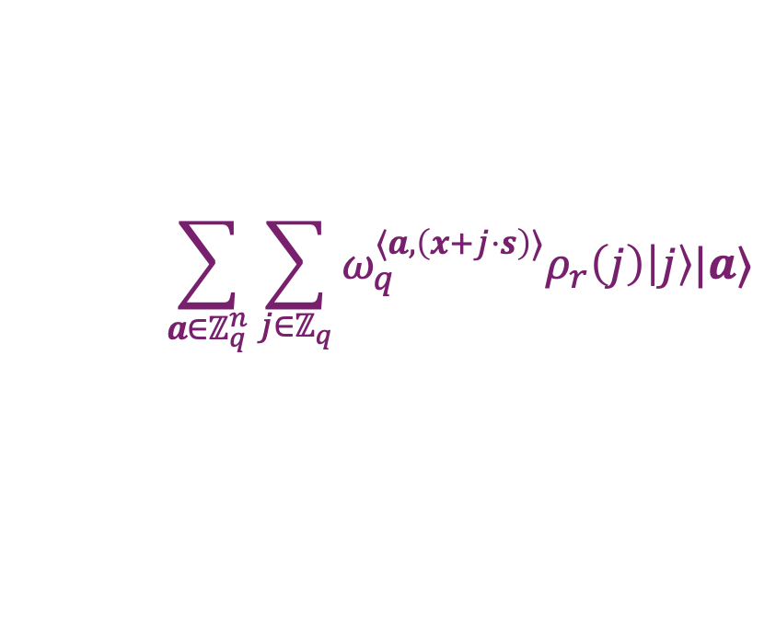
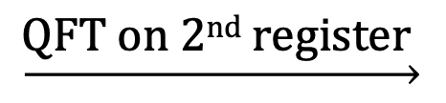

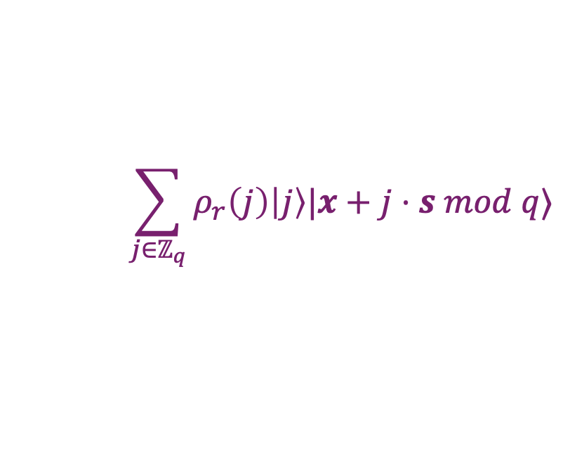
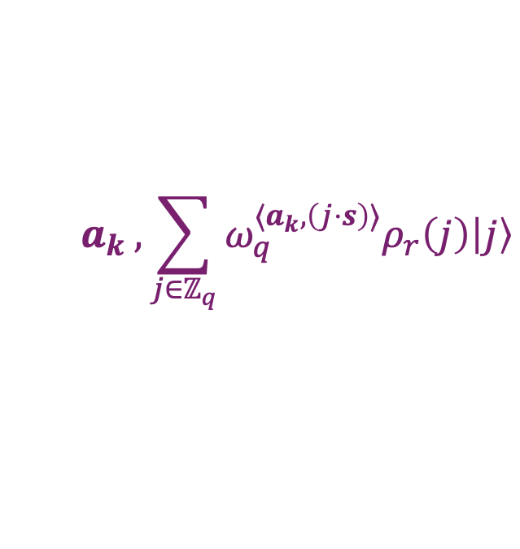
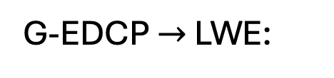

LWE $≡$ Extrapolated DCP
$ρ_{r}\left(j\right)=e^{−πj^{2}/r^{2}}$
G-EDCP $→$ LWE:
Want to utilize the Gaussian amplitudes to get LWE samples
$$\sum_{j∈ℤ_{q}}{ρ_{r}\left(j\right)\left|j\right\rangle |x+j⋅s mod q⟩}$$
Given a G-EDCP state:
$$\underset{→}{\text{Q}\text{FT} \text{on}\text{ 2}\text{nd} \text{register} }$$
$$\sum_{a∈ℤ_{q}^{n}}{\sum_{j∈ℤ_{q}}{ω_{q}^{⟨a,\left(x+j⋅s\right)⟩}ρ_{r}\left(j\right)\left|j\right\rangle |a⟩}}$$
$$a_{k} , \sum_{j∈ℤ_{q}}{ω_{q}^{⟨a_{k},\left(j⋅s\right)⟩}ρ_{r}\left(j\right)\left|j\right\rangle }$$
$$\underset{→}{\text{Measure}\text{ 2}\text{nd} \text{register}}$$
LHS of LWE sample

Slide 15











LWE $≡$ Extrapolated DCP
Poisson Summation:
$$ρ\left(ℤ+u\right)=r\sum_{x∈ℤ}{\exp\left(2πιxu\right)ρ_{1/r}(x)}$$
$$a_{k} , \sum_{j∈ℤ_{q}}{ω_{q}^{⟨a_{k},\left(j⋅s\right)⟩}ρ_{r}\left(j\right)\left|j\right\rangle }$$
$$a_{k} , \sum_{b∈ℤ_{q}}{\sum_{j∈ℤ}{ω_{q}^{j(\left\langle a_{k}, s\right\rangle +b)}ρ_{r}\left(j\right)\left|b\right\rangle }}$$
$$\underset{→}{\text{Q}\text{FT} \text{on}\text{ 1}\text{st} \text{register} }$$
Like RHS of LWE sample
$$a_{k} , \sum_{b∈ℤ_{q}}{\sum_{j∈ℤ}{ρ_{1/r}\left(j+\frac{\left\langle a_{k}, s\right\rangle +b}{q}\right)\left|b\right\rangle }}$$
$$=$$
Poisson Summation
$$= a_{k} ,\sum_{e∈ℤ}{ρ_{1/r}\left(\frac{e}{q}\right)\left|\left\langle −a_{k}, s\right\rangle +e mod q\right\rangle }$$
$$e≔qj+\left\langle a_{k}, s\right\rangle +b$$
$$\underset{→}{\text{Measure} }$$
$$a_{k} ,\left\langle −a_{k}, s\right\rangle +e_{k} mod q$$
${ℙ[e}_{k}]=ρ_{1/r}^{2}\left(\frac{e_{k}}{q}\right)$ = $ρ_{\frac{q}{r\sqrt{2}}}\left(e_{k}\right)$

Slide 16




S$|$LWE$⟩$
Another attempt at quantum algorithms for LWE
Chen, Liu and Zhandry [CLZ22] defined quantum versions of LWE.
$S|LWE⟩$: Instead of $b=\left\langle a,s\right\rangle +e$, give a quantum state
  Samples: $a←ℤ_{q}^{n}, \left|φ\right\rangle ≔\sum_{e∈ℤ_{q}}{f\left(e\right)\left|\left\langle a,s\right\rangle +e mod q\right\rangle }$
  Find $s$
If $f$ is discrete Gaussian
$$f\left(e\right)=ρ_{r}\left(e\right)$$
Can measure $\left|φ\right\rangle$to get $\left\langle a,s\right\rangle +e mod q$ with probability ${\left|f\left(e\right)\right|}^{2}$
(LWE sample)
[CHLLT25] reduce one such sample to a DCP state with inverse subexp probability!
Can start with subexp samples and get subexp DCP states.
Then apply Kuperberg’s sieve for a subexp algorithm.

Slide 17








LWE reduces to S$|$LWE$⟩$^{phase}
S$|$LWE$⟩$^{phase} : Have an unknown phase term in the quantum state
Samples: $a←ℤ_{q}^{n}, y←D_{θ}, \left|φ\right\rangle ≔\sum_{e∈ℤ_{q}}{f\left(e\right)⋅\exp\left(2πιeθ\left(y\right)\right)⋅\left|\left\langle a,s\right\rangle +e mod q\right\rangle }$
Possibly uncomputable function
The unknown phase
A distribution over domain of $θ$
LWE
G-EDCP with unknown shift
S$|$LWE$⟩$^{phase}
$$\sum_{j∈ℤ_{q}}{ρ_{r}\left(j−c\right)\left|j\right\rangle |x_{k}+j⋅s mod q⟩}$$
Loosely similar to LWE $→$ G-EDCP
Similar to G-EDCP $→$ LWE
Error prob.: inverse exp instead of inverse poly
Cost: Unknown center $c$

Slide 18

Couple of open questions
  The unknown phase is small and follows Gaussian distribution, so can making a guess of the phase help?
  Can we reduce more structured variants of LWE to $S|LWE⟩$ / DCP?
    Ring-LWE, Module-LWE
      Instead of vectors, have polynomials (RLWE)/ module over polynomials (MLWE)
      Advantage: Efficient schemes
      Used in practical schemes (Kyber, Dilithium)
    Sparse LWE
      Each $a_{i}$ has only $k(≪n)$ non-zero entries.
      Motivation: Efficient schemes

Slide 19
Thank You

